Slide 1
Project Report on Black Friday Data Analysis
Author : MR. HARSH NEMA

Slide 2

Black Friday sale
The Black Friday is a major shopping event that takes place on the day after Thanksgiving in the United States, which is the fourth Thursday of November.
Black Friday has become a major retail event, with retailers offering significant discounts and promotions on a wide range of products, from electronics and appliances to clothing and toys.
In recent years, Black Friday has expanded beyond the United States to become a global phenomenon, with retailers in countries around the world offering their own Black Friday deals.
By conducting an analysis, retailers can effectively develop a personalized recommender system, which can provide tailored product suggestions to customers during sales events.

Slide 3
Objective
A retail company “ABC Private Limited” wants to understand the customer purchase behavior (specifically, purchase amount) against various products of different categories.
To analyze the purchase amount of customer against various products which will help them to create personalized offer for customers against different products.
To focus on understanding the customer behavior during Black Friday sales and identifying ways to optimize sales and revenue.

Slide 4
DATASET Information
The dataset contains 11 features including target feature ‘Purchase’.
Train data contains 550068 rows and 12 columns.
Test dataset contains 233599 rows and 11 columns and it doesn’t have target feature ‘Purchase’.
Train and test data merged into one dataset.
Data integrity check is perform for missing values

Slide 5
Methodology of project
Phase 1 Train and test data were merged into one data frame
Phase 2 Data cleaning, Data preprocessing on merged data to create error-free, clean dataset.
Phase 3 EDA to gain key insight about purchase behavior of customers during Black Friday Sales

Slide 6
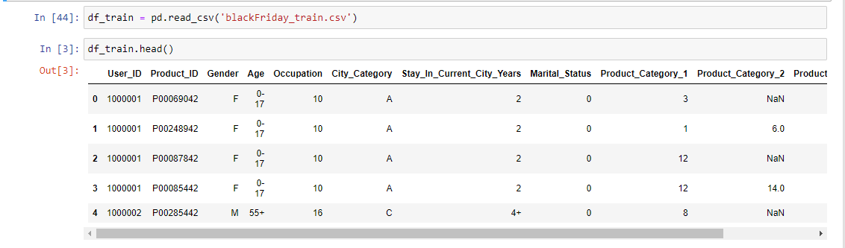
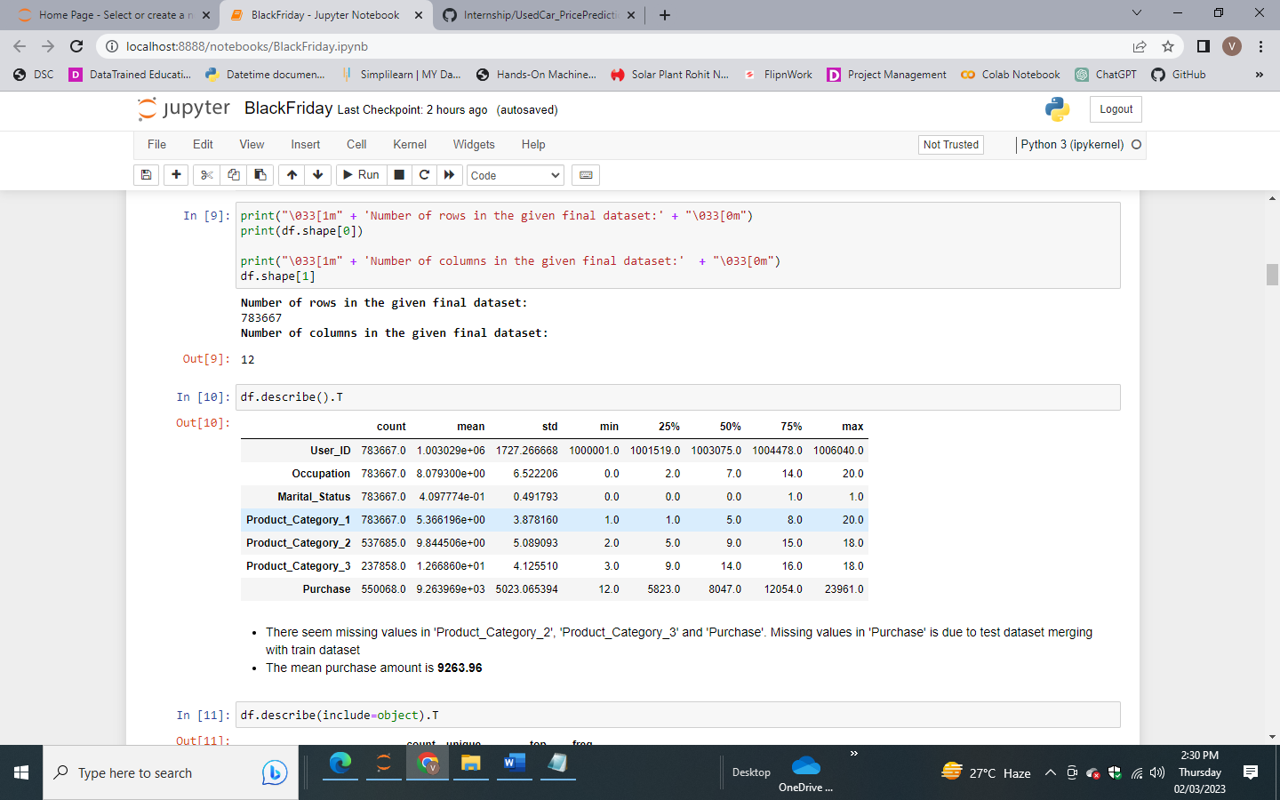
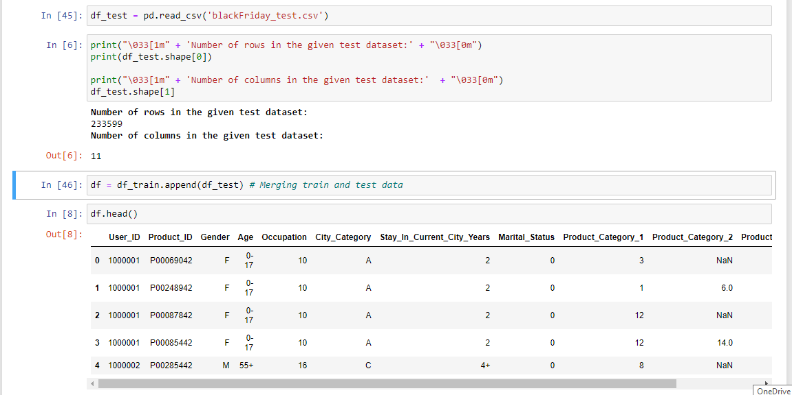
Merging train and test data

Slide 7
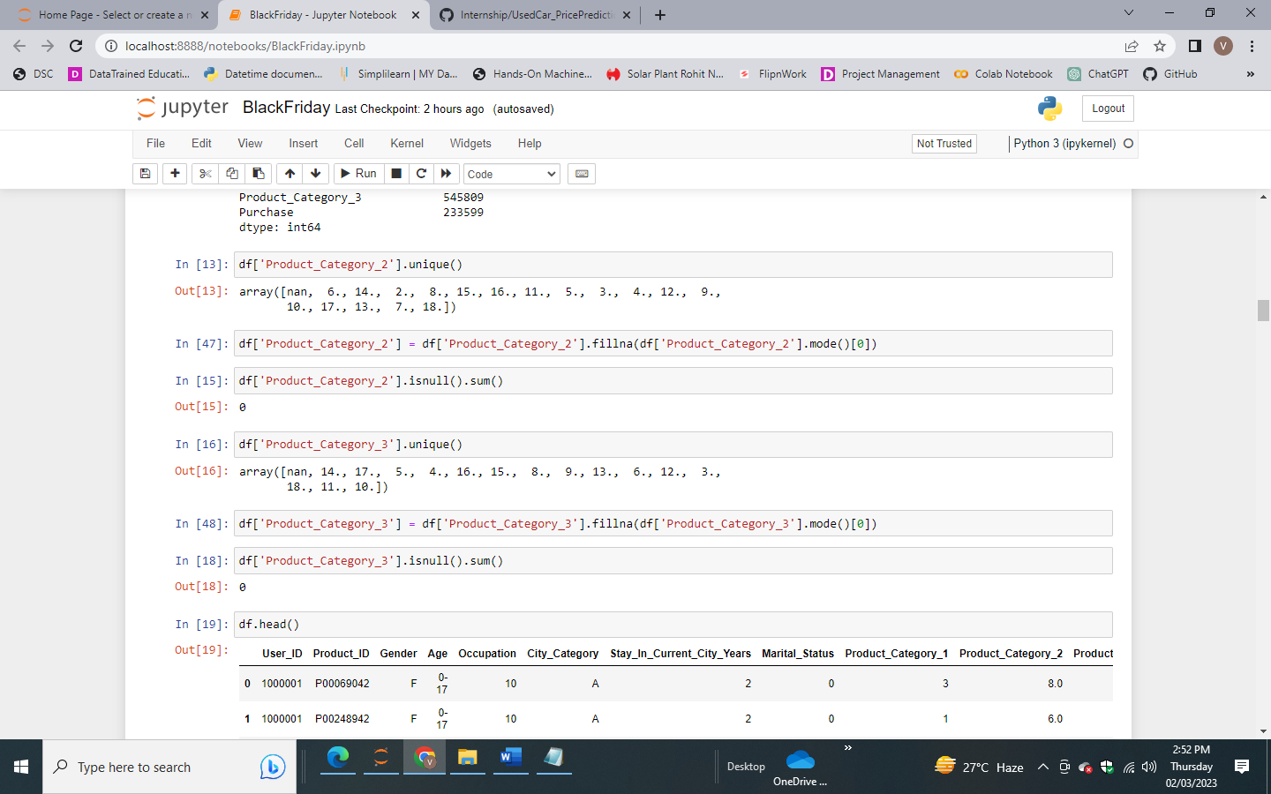
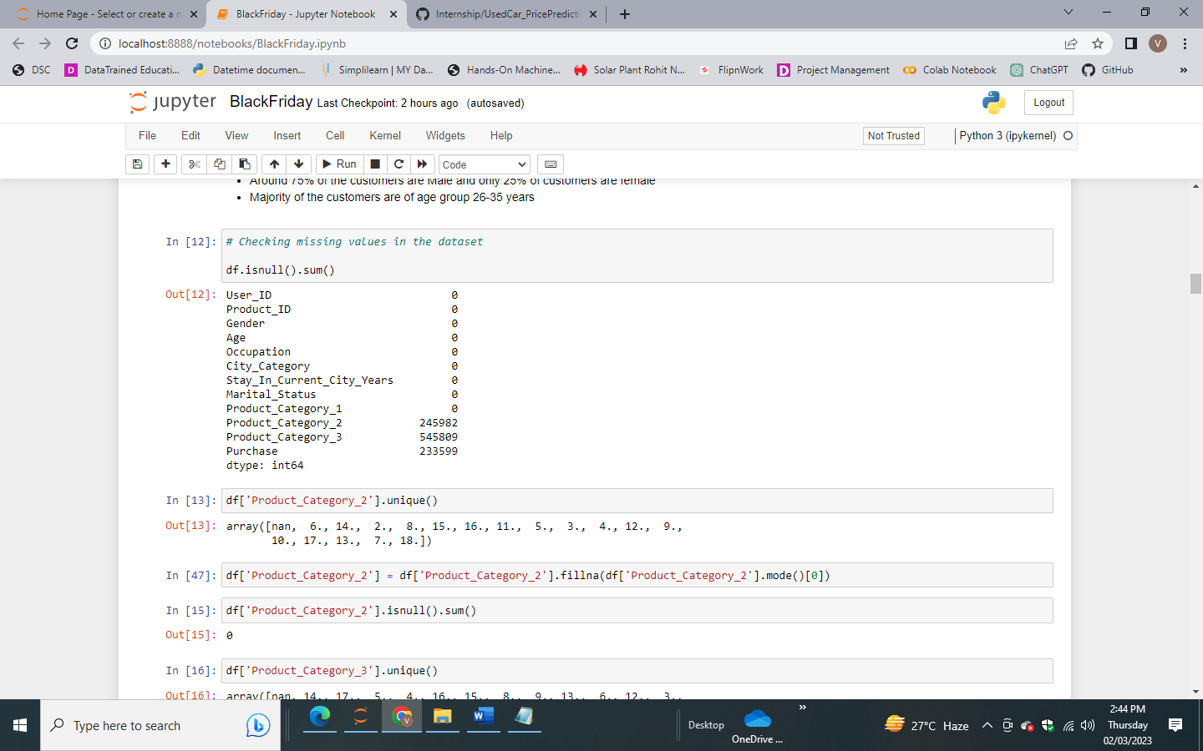
Missing Value imputation
Missing Value before Imputation
Imputation of Missing Value for Categorical Variable

Slide 8
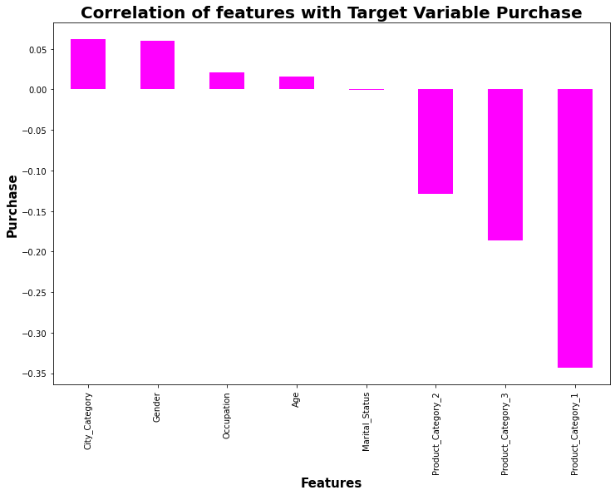
Data Inputs- Logic- Output Relationships
As the Product Category 1, 3, and 2 increase, the Purchase amount tends to decrease. In other words, customers tend to spend less money on products in these categories.
Customers from certain cities, genders, occupations, and age groups tend to spend more money.

Slide 9
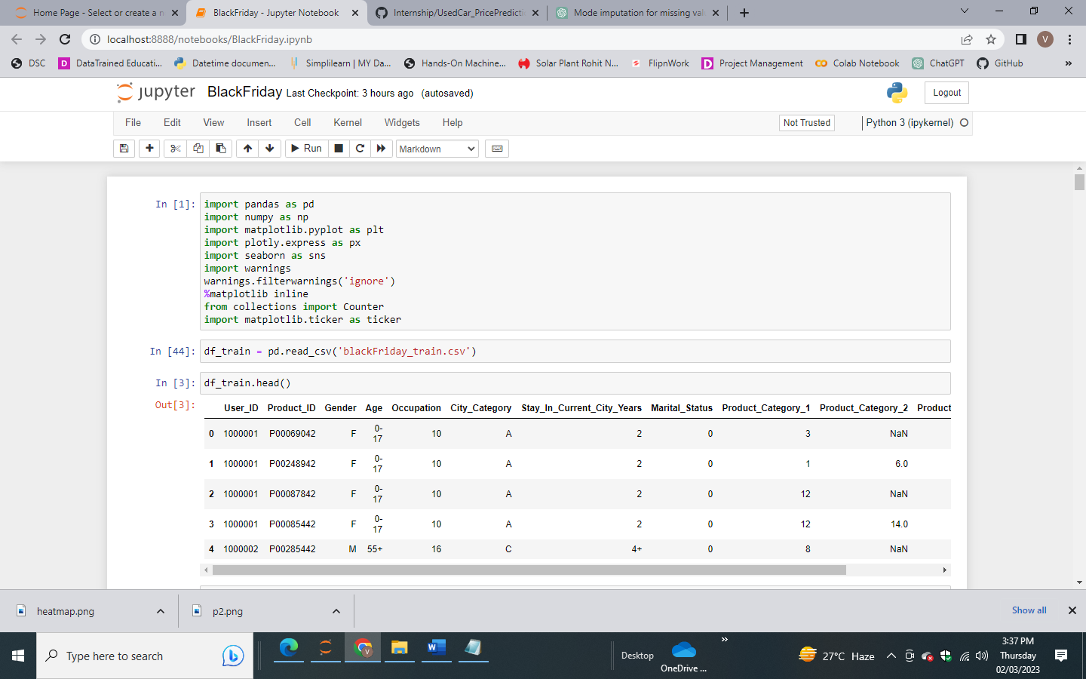
PYTHON Libraries USED IN THIS PROJECT
Visualisation libraries used

Slide 10
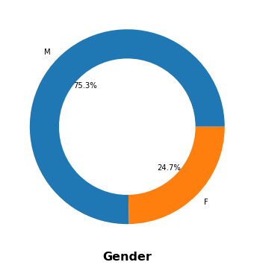
Exploratory Data Analysis gender distribution
Males are almost 3 times more likely to participate in Black Friday shopping compared to females.
It helps to plan the marketing strategies and promotions for the upcoming Black Friday sales, by targeting the messaging to the male or female audience.

Slide 11
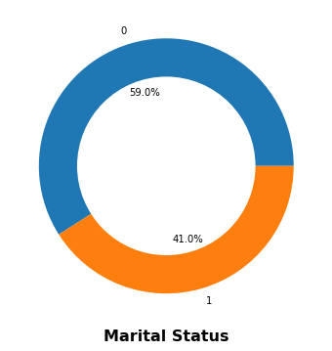
Exploratory Data Analysis Marital status DISTRIBUTION
Unmarried individuals were more likely to make purchases on Black Friday compared to married individuals.
It is possible that unmarried individuals had more time, flexibility, or disposable income to shop on Black Friday.

Slide 12
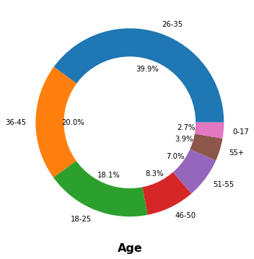
Exploratory Data Analysis age group DISTRIBUTION
The largest age group of Black Friday shoppers are those aged between 26 and 35 years, accounting for almost 40% of the shoppers.
The second largest group is the 18-25 age group, making up 18.1% of the total number of shoppers.

Slide 13
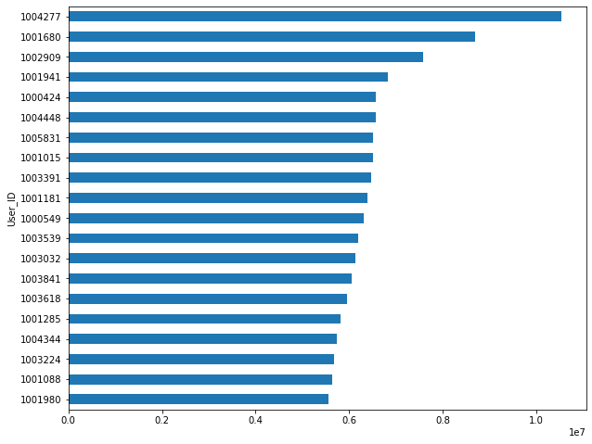
Exploratory Data Analysis Top 20 spending users
User ID 1004277 tops the list with the highest amount spent
By understanding user needs and preferences, a seller can tailor their products, pricing, and customer service offerings to better serve these customers and increase their loyalty.

Slide 14
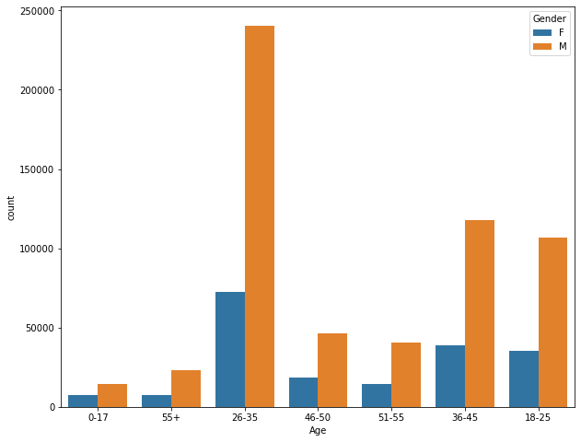
Exploratory Data Analysis User distribution by age group and gender
Most of the users who participate in the Black Friday Sale are from age group 26-35, 36-45 and 18-25.
Younger consumers tend to be more tech-savvy, which makes it easier for them to shop online during Black Friday sales.

Slide 15
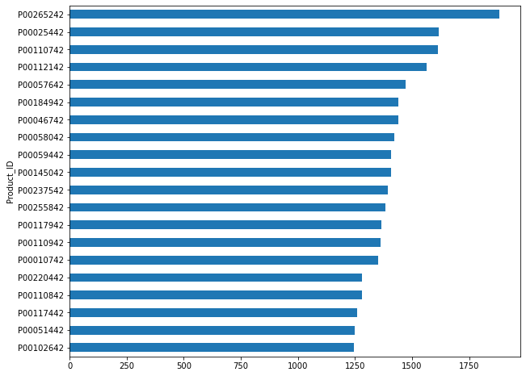
Exploratory Data Analysis Top 20 Products in Black Friday Sale
The most popular products may help the merchant adjust their business strategy and can prepare for the next shopping season better so that to Increase revenue and profit.

Slide 16
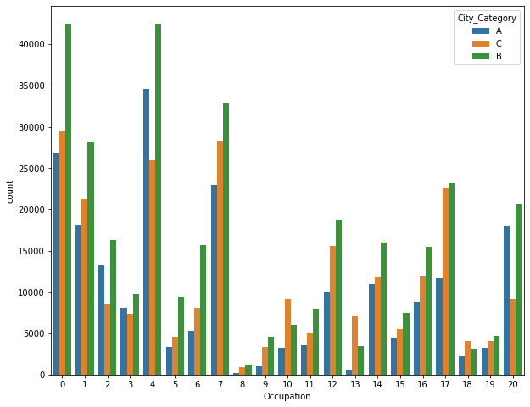
Exploratory Data Analysis User distribution by Occupation and City
Users from Citi B did more shopping comparing to users from City A & Citi C.
The reason is City B is larger than City A & Citi C and thus has a larger population
Customers from occupation 0, 4, 7 did more shopping than other occupations

Slide 17
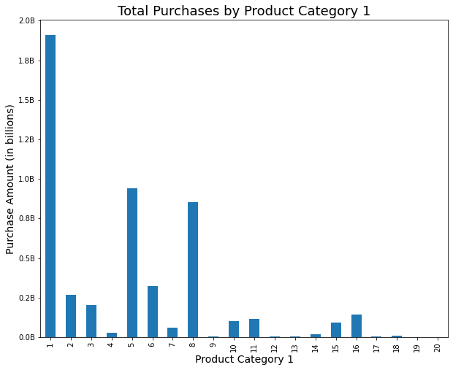
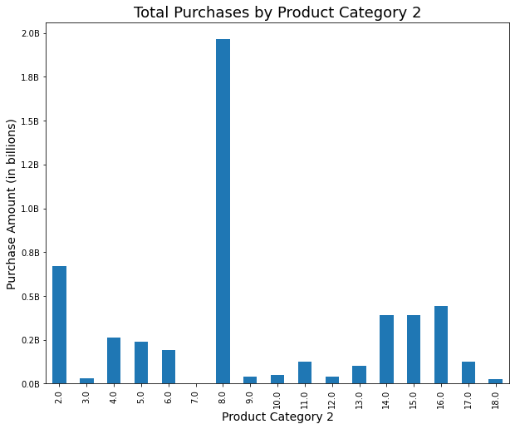
Exploratory Data Analysis Purchase Vs Product Category 1 and 2
Product 1 was highly purchased, amounting to 1.9 billion.
Product 8 was highly purchased, amounting to 2 billion

Slide 18
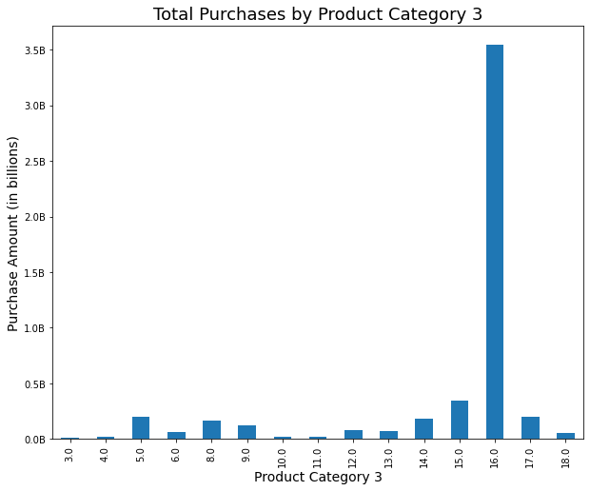
Exploratory Data Analysis Purchase Vs Product Category 3
Product 16 in Product category 3 was purchased up to 3.5 billion.

Slide 19
conclusion
The data shows that males are more likely to participate in Black Friday shopping than females.
The largest age group of shoppers are those aged between 26 and 35 years.
Unmarried individuals were also more likely to make purchases on Black Friday compared to married individuals.
City B did more shopping compared to users from City A and Citi C.
The data reveals that users from occupations 0, 4, and 7 did more shopping compared to users from other occupations.
The most popular products were Product 1 in Product Category 1, Product 8 in Product Category 2, and Product 16 in Product Category 3.

Slide 20


